Slide 1
Bringing intelligence to where your data lives
in-database advance analytics & machine-learning
Bogdan Mortu, SQL Developer
Bucharest • 22 April 2019

Slide 2

Agenda
SQL Server ML Services – principles & architecture
Demo - sp_execute_external_script – running Python in T-SQL Code
Demo - Azure Data Studio Notebooks (SQL as kernel)
Demo – RevoScalePy Python package

Slide 3
SQL Server ML Services – principles & architecture

Slide 4
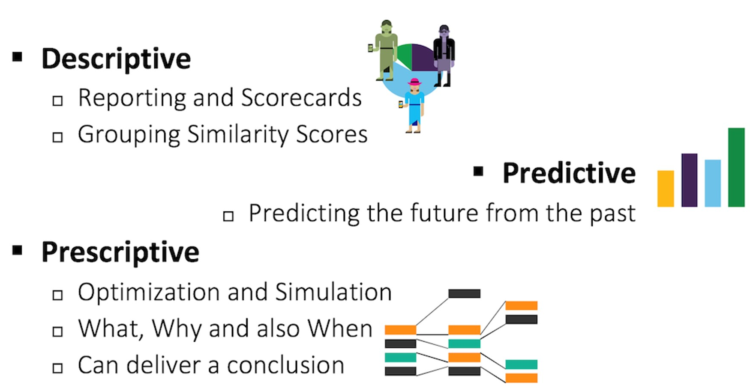
Types of Analysis

Slide 5
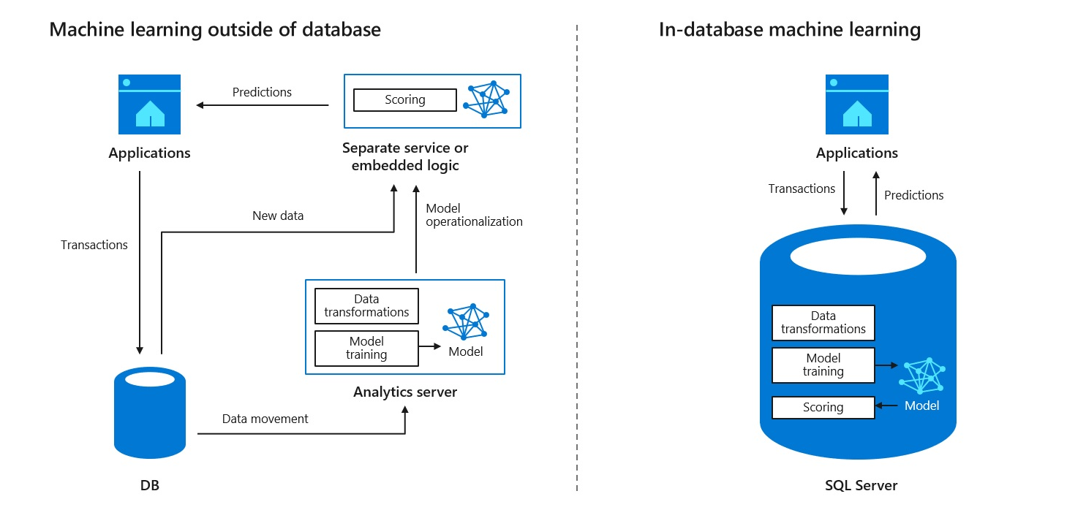
Outside vs In-database machine learning

Slide 6
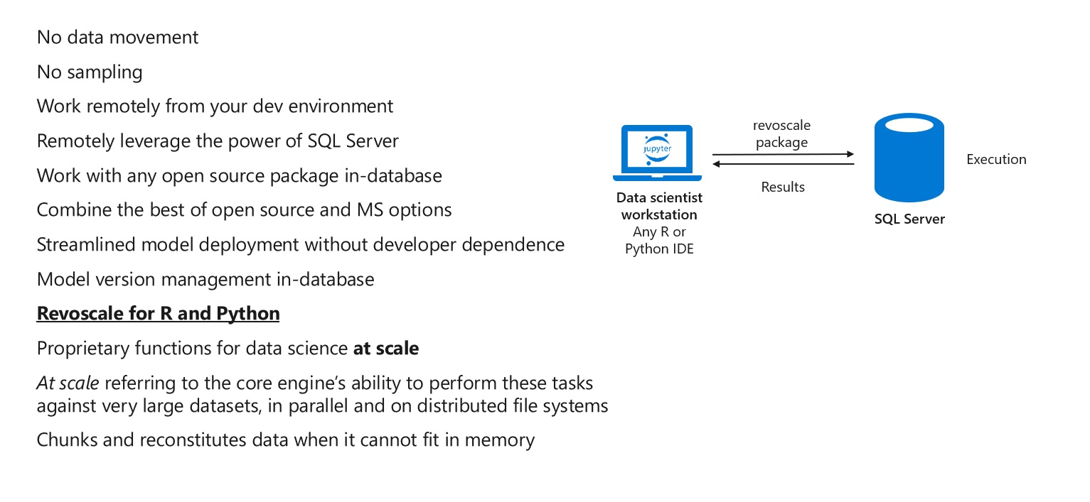
SQL Server ML Services makes it easy

Slide 7
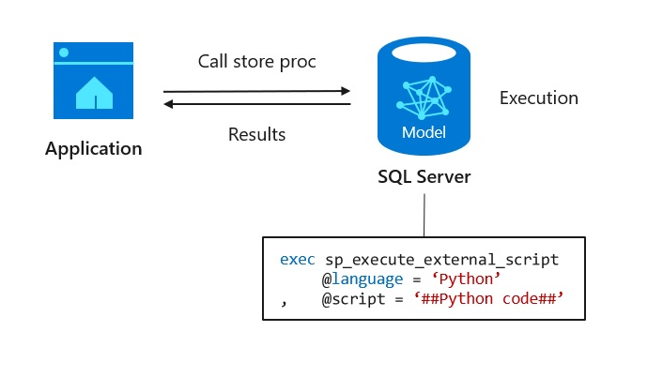
Data and application developer – model consumption

Slide 8
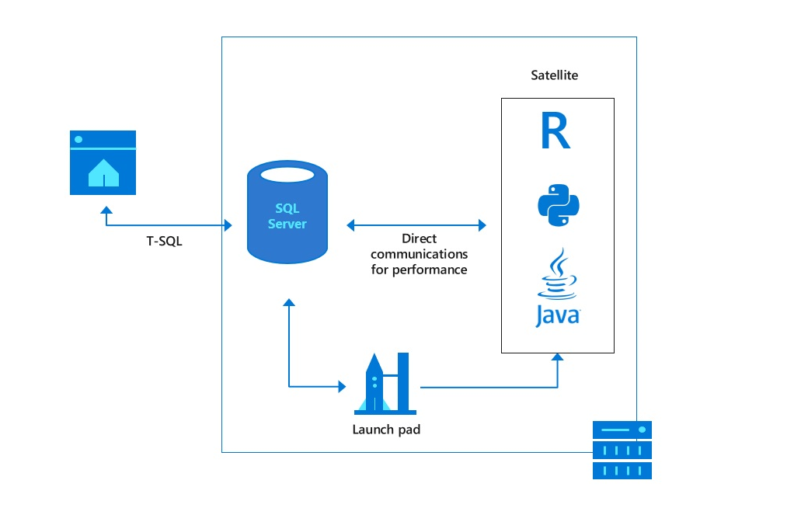
Extend T-SQL with R, Python and Java

Slide 9
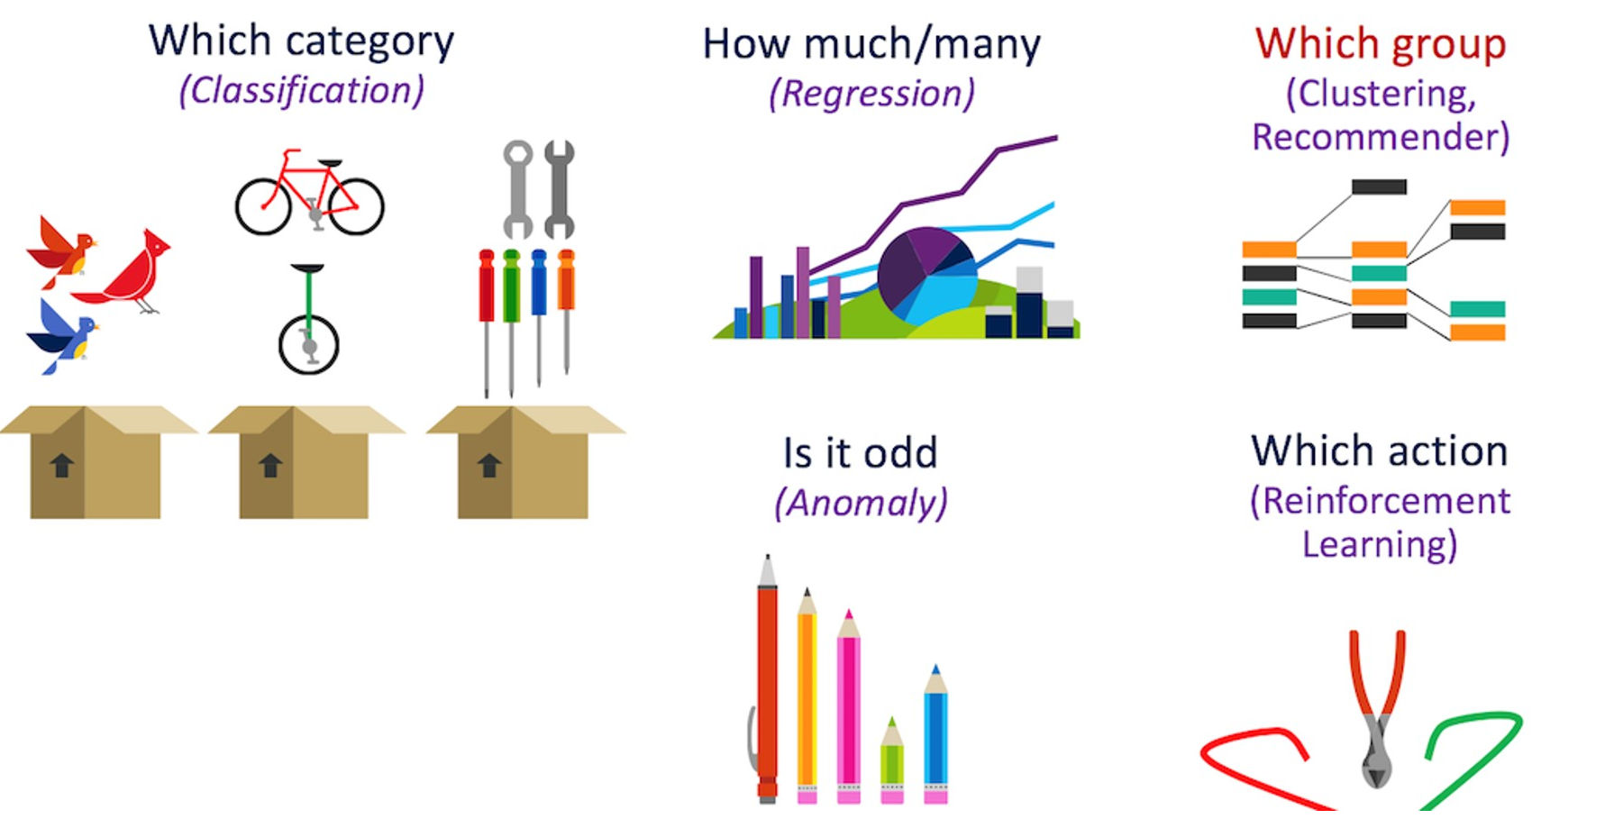
DEMO – Machine Learning

Slide 10
Thank you

